Slide 1

MINI PROJECT
A web-based dashboard for global electric vehicle market

Slide 2


Objective
To build a web-based dashboard to provide business analysis insights of the global Electric Vehicle market

Slide 3
Solution Architecture
Following table shown the four main components to construct this project
Component | Technology
Front-end (Web Server) | NodeJS and ReactJS
Back-end (App Server) | Python and Flask
Database | SQLite
Hosting | Azure to host back-end (App Server) AWS to host front-end (Web Server)

Slide 4










Solution Architecture
Following diagram illustrated the solution architecture of this mini project
Users access the page from web browser
Azure redirect request to App Server
Web application consuming Web API which hosting on Azure
App Server retrieve data from database
AWS host and open the React Application

Slide 5


Front-end Implementation Detail
Use ReactJS as front-end framework to create, design, and control the Web UI
Use Recharts third-party library to build the diagram and charts of the Web UI
Use Volt Themesberg as a web template to build the Web UI

Slide 6



Back-end Implementation Detail
Use Python 3 to build back-end application
Use Flask Framework to build Web API
Use SQLite database to store application data

Slide 7
Web User-Interface Design
Detail of the web UI design

Slide 8
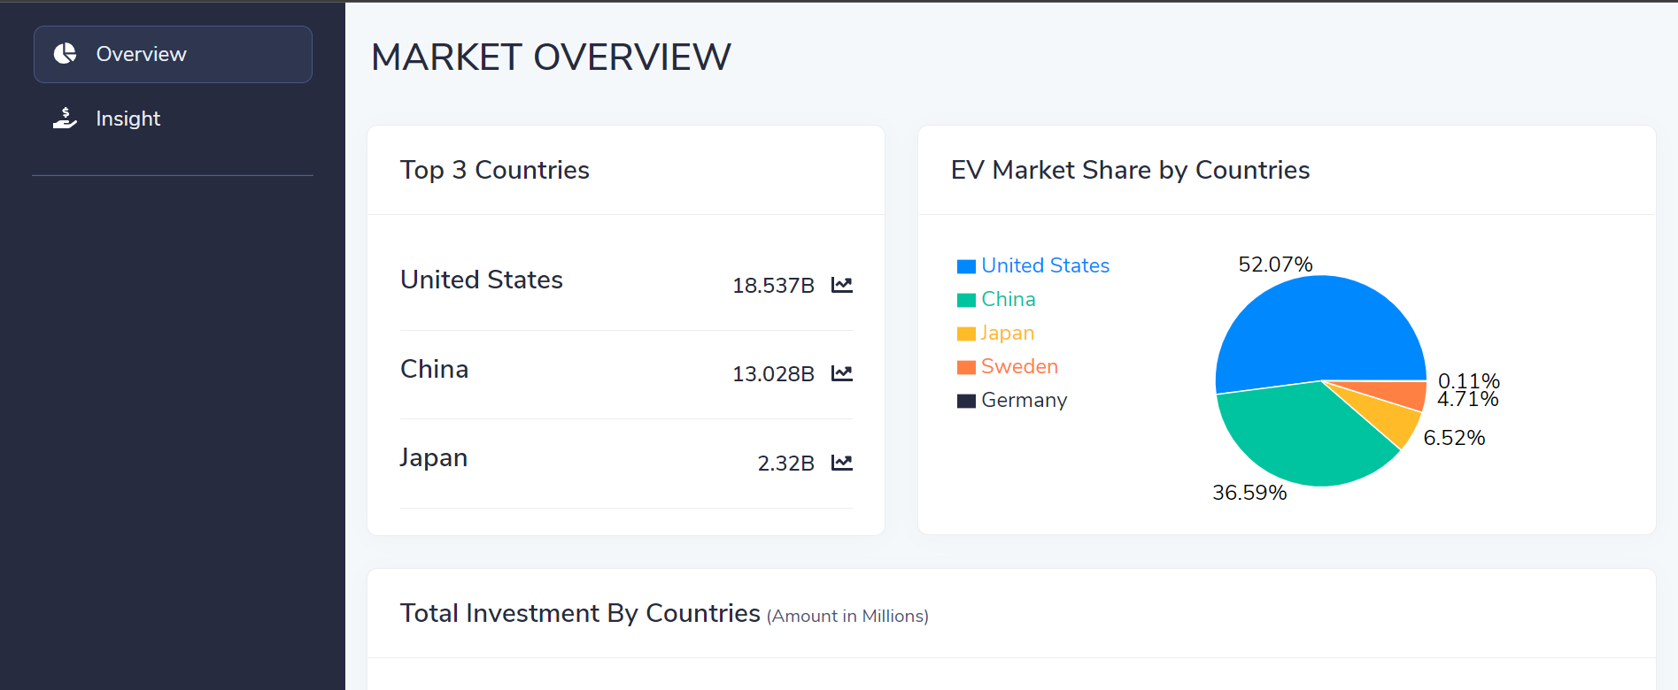



Dashboard
Have a global business analysis insights at a glance

Slide 9
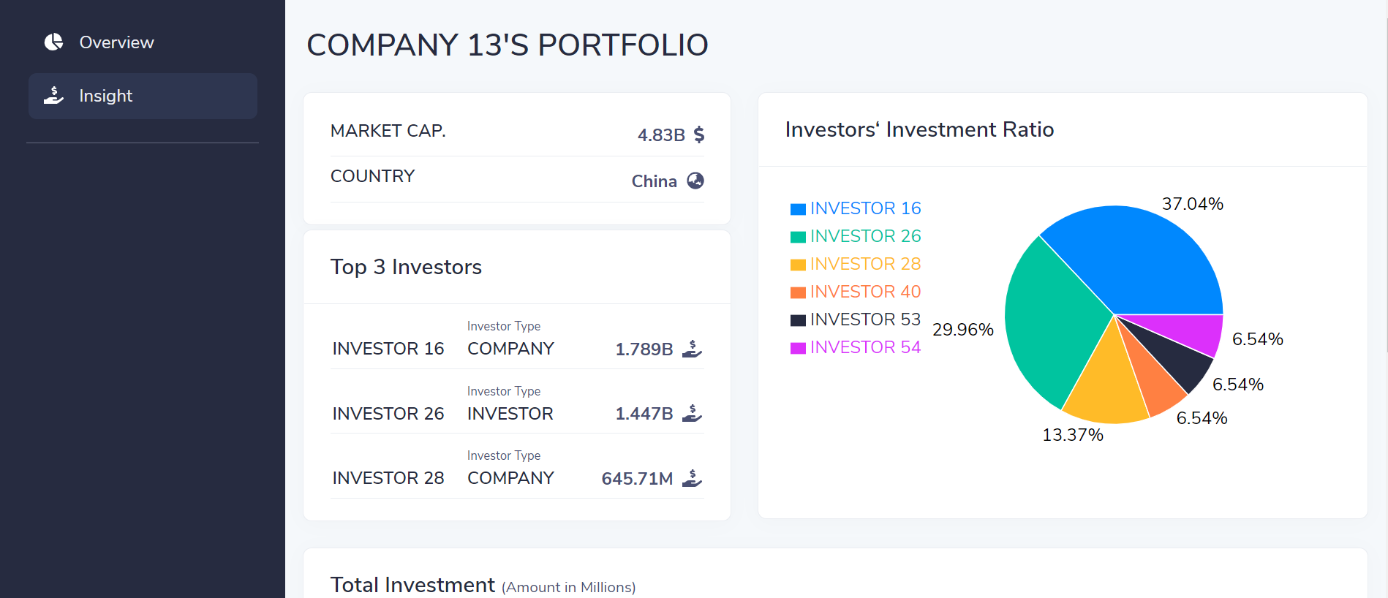
Insight
Drill into more detail of the EV company

Slide 10
Resource Links
Following listed the resource links for this mini project
Resource Name | Link
Website Link | https://main.d3kv0ue37v9221.amplifyapp.com/
GitHub Link for Front-end Source Codes | https://github.com/Gabriel133/miniprj4deloitte.git
GitHub Link for Backend-end Source Codes | https://github.com/Gabriel133/miniprj4Deloitte-backend.git

